Slide 1
Introduction to the
Listening to Indigenous Voices/ À l’écoute des voix autochtones Curriculum Mapping Guides
A Joint Project of the EOCCC and ICE
Notes:
This 15 slide presentation will provide a brief overview of the Listening to Indigenous Voices resource from the Jesuit Forum and explain how the Curriculum Mapping Guides (both in English and in French) work. The curriculum mapping guides are available on both the EOCCC and ICE websites at www.eoccc.org and www.iceont.ca

Slide 2
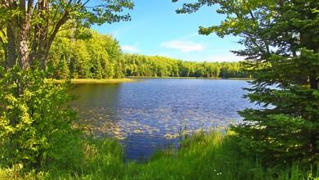
We acknowledge that today we gather on the traditional territories
of Indigenous People.
As settlers, Canadians and persons of faith, we make this acknowledgement of the land in recognition that we are called to be allies, partners, and good neighbours who actively listen to and learn from our Indigenous brothers and sisters. We seek truth as the only path forward to reconciliation and we commit ourselves to knowing our own story, our shared story,
and the stories from before our time on this land,
so that the story we continue to weave today
may be one of justice and peace for all.
Notes:
We invite you to name the Indigenous people of your geographical area as well as the treaties that cover the land where you are.

Slide 3
Our Opening Prayer / Prions ensemble
Let us pray +
Viens, Esprit créateur, visite l’âme de tes fidèles,
kindle in them the fire of your love,
Send forth your spirit and they shall be created,
And you shall renew the face of the Earth.
Amen.
Notes:
The curriculum mapping guides, in both French and English, encourage educators to begin with this prayer. The Holy Spirit, of course, is promised to lead us in all truth, give us courage and right judgement and comfort those in need.

Slide 4
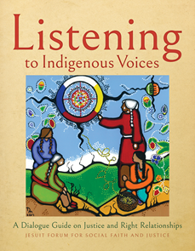
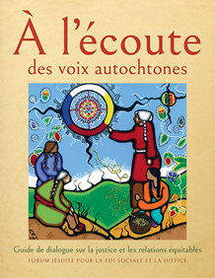
The Resources: Listening to Indigenous Voices/À l’écoute des voix autochtones
Published by Novalis – May 2021
A dialogue guide on justice and right relationships by the Jesuit Forum
Indigenous contributors for articles as well as art
Under the guidance of an advisory committee that included Indigenous contributors
To order the text, contact Novalis: Maria Madeiros
maria.medeiros@novalis.ca
Notes:
The dialogue guide from the Jesuit Forum is a paperback spiral bound resource with full colour illustrations and articles on a variety of topics regarding historical and present day concerns in the lives of Indigenous people.
The guide is available in French and English.

Slide 5
The Outline of the Dialogue Guides
Prologue and 11 sessions/ Prologue et 11 réunions
Each session includes:
Articles/textes
Artwork/oeuvres d’art
Questions for reflection/Cercle de partage
Classroom connections/ pour le travail en classe
Notes:
The prologue to the guide provides helpful information about how to use the resource in an adult group discussion setting. The classroom connections provided in the guide itself for each session are also helpful although they are generalized and not linked concretely to curriculum expectations.
The purpose of the curriculum mapping guides is to make explicit the specific expectations that can be met in Curriculum for grades 9 to 12 in subjects such as history, art, religious education, law, French as a second language and extended French courses (when using the French version of the guide) etc. Because of the level of language, it is likely that French teachers will use these materials only with students in grade 10 or beyond. The French curriculum mapping guide has helpful information for French teachers.
We did not list the many connections to Native Studies curriculum as these were seen to be more obvious. Our hope is to help teachers see the connections to the many other areas where these guides - French and English - can provide excellent and relevant material.

Slide 6
The 11 sessions / les 11 réunions
Beginnings – a focus on Creation stories Au commencement
A Tale of Two Communities – discussion of the issue of water – pollution/access/justice Le conte des deux communautés
The Land is Us – focus on an Indigenous understanding of land La terre, c’est nous
Languages of the Land – focus on the variety and richness of Indigenous languages Les langues de la terre
Ties of Kinship – understanding treaties as covenant relationships Des liens de parenté
Notes:
This is a list of the 11 sessions of the discussion guide with a very brief summary of the subject matter for each.

Slide 7
6. Early Encounters – a historical look at early European colonization Premières rencontres
7. Killing the Indian in the Child – a look at the devastating government policies that sought the forced assimilation of Indigenous people and the resulting cultural genocide Tuer l’Indien chez l’enfant
8. Dispossession, Dependency, & Oppression – a look at the ongoing dynamics of colonization Dépossession, dépendance et oppression
9. Beyond Apologies – a look at what is meant by and needed for reconciliation Au-délà des excuses
10. Pathways to Decolonization – a look at what decolonization may look like Des pistes vers la décolonisation
11. Re-Indigenization – focus on what this means for Indigenous and settler people alike L’autochtonisation

Slide 8
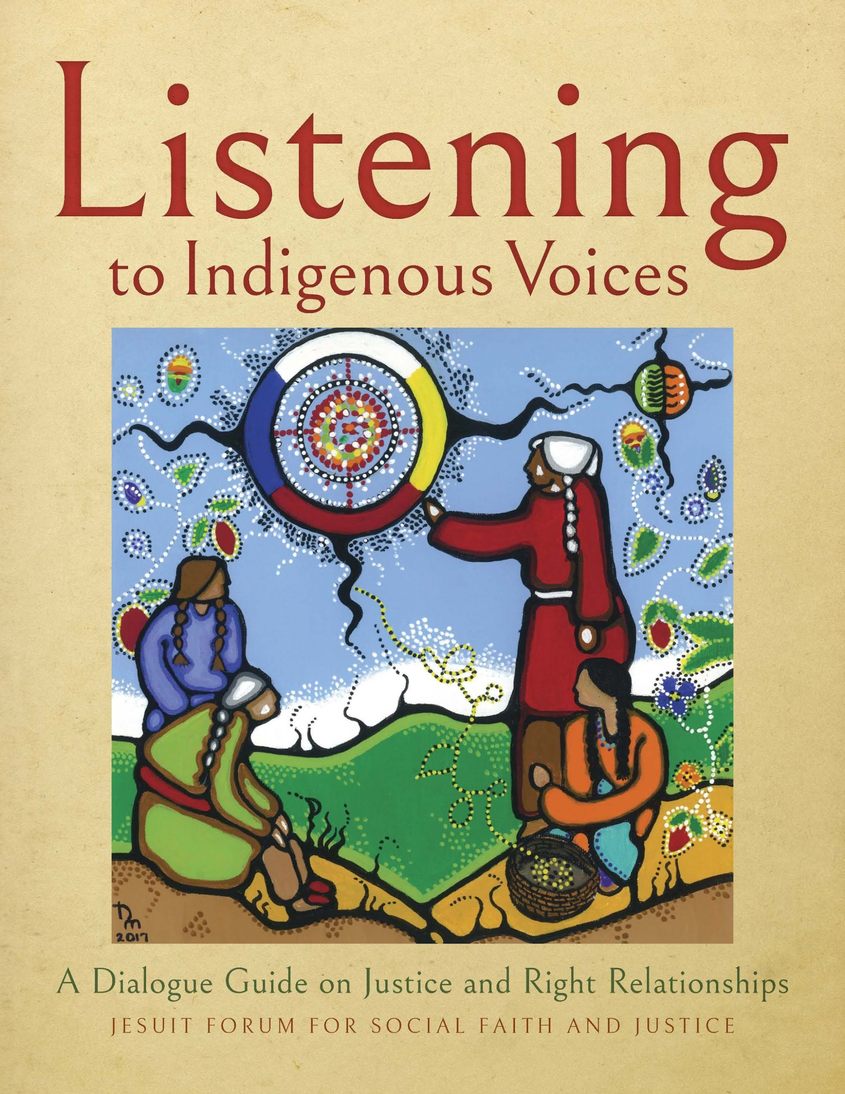
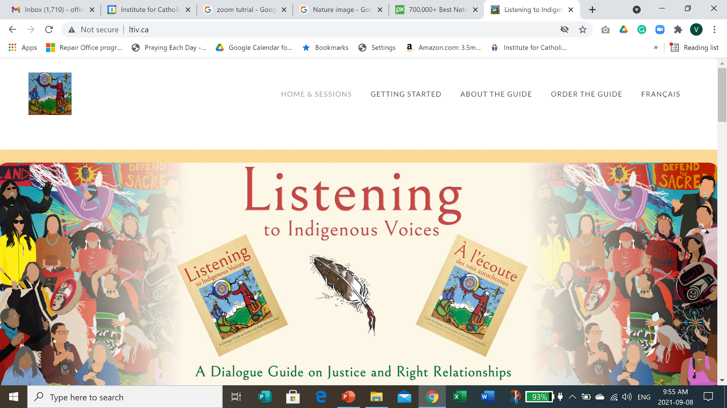
The Dialogue Guides and the Website ltiv.ca
What’s the difference?
Notes:
Along with the printed guide, there is also an associated website with supplementary materials. www.ltiv.ca gives you access to videos and worksheets related to each session. As this website is free, educators may want to take a look. We do suggest, it is always best to use supplemental materials in context rather than using them on their own. It is important to note that the Jesuit Forum is solely responsible for the material on the website (that is, Novalis is not publishing this material). It is also an ongoing project for the Jesuit Forum so not every session has supplemental material uploaded to address its content. Educators are cautioned to preview any materials here carefully as websites can change and not all material may be suitable for all grade levels.
Also note: While the French printed guide is a translation of the English printed guide, the website materials are not translated. That is, video selections for the English language sessions vary from the selections for French.

Slide 9
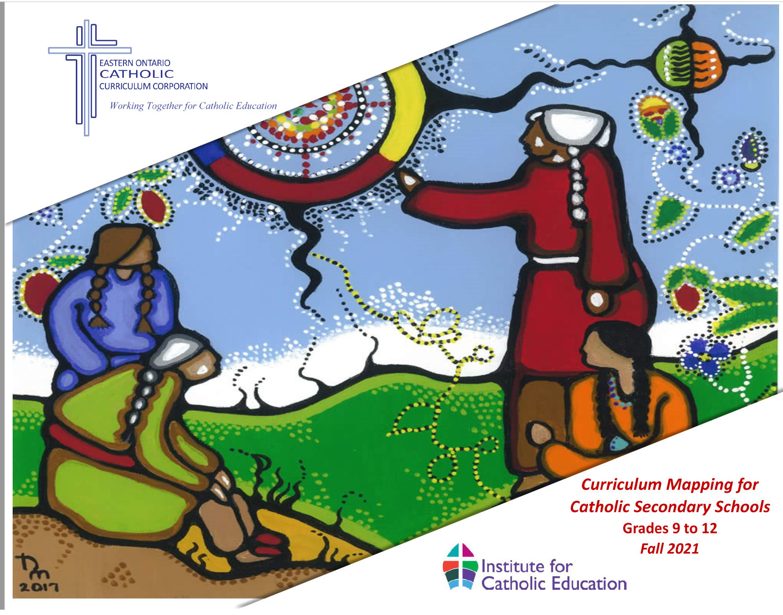
Listening to Indigenous Voices – Curriculum Mapping for Catholic Secondary Schools
Notes:
The two curriculum mapping guides - one for all Ontario curriculum in English and one for FSL and Extended French using the French guide - provide a wealth of information for teachers. They are available on the EOCCC or ICE websites for download. They are living documents with live links to the ltiv.ca website. We hope to continue to refresh the guides as more materials are put online.

Slide 10
What the curriculum mapping guides provide
Front matter for each session:
Brief Description of the session
Scripture link
Links to Catholic Social Teaching
Links to United Nations Sustainable Development Goals
Sample land acknowledgement tied to the session learning
Curriculum charts:
Expectations from Secondary curriculum by grade, subject, and course code
Note that the French mapping guide highlights courses that are most often offered in the Extended and/or Immersion programs
Hyperlinks to the material to make access as easy as possible for the classroom teacher
Notes:
The curriculum mapping guide is organized according to the 11 sessions. For each session, there is Front Matter (more generalized information for the teacher - making important links to Catholic Social Teaching, etc.) followed by the specific Curriculum charts. We highly recommend teachers take time to review the Front Matter for each section.

Slide 11
Notes:
What you will notice:
The table of contents lists the Sessions along with the courses that have links to that material. The table of contents is live linked so clicking on the page number of any particular session will take you to the Front Matter for that session.
While many links have been made to many courses, we expect some educators might identify others. The curriculum mapping guide is intended to highlight the main courses where links can be made.
YOU WILL NOTE that some courses only appear in 1 or 2 sessions. As you may be looking at materials outside of their fullest context, we encourage you to work through the learning in the PROLOGUE so as to ensure that you “do this work in a good way”.

Slide 12
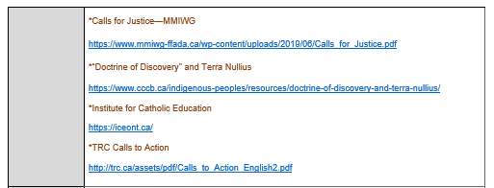
Notes:
Here you see some of the material from the PROLOGUE. Live links here can link to the supplementary material on the ltiv.ca website or to other outside sources. You will note that the asterisk * beside a website denotes that it is an external source.

Slide 13
Session 1 Beginnings – sample mapping chart
Notes:
Here is an example of a curriculum map for Gr 10 History. Note the colour. The Curriculum Mapping Guide is colour coded so each subject appears in the colour of its curriculum document cover. This helps educators identify the course subject quickly.
The course Title and Code appear in the top line.
Curriculum Expectations follow taken directly from the course curriculum document.
Links to the LTIV guide and website material are listed
The Focus indicates what part of this material is relevant to the curriculum in question.
A variety of Suggested Learning Experiences are listed.
Finally, there are sensitivity notes to alert educators to difficult topics.

Slide 14
Réunion 2 Le conte des deux communautés
Notes:
Here is an example from the French Curriculum Mapping Guide. You will note that the Expectations are in English as the curriculum documents for FSL and Extended French and French immersion are in English.
The chart is purple to reflect the FSL curriculum document.

Slide 15
We encourage you to explore these Curriculum Mapping Guides on your own as well as in conversations with your colleagues, department heads, your board’s Indigenous Lead, your board’s Religious Education Consultant and your board’s FSL Consultant.
Both the EOCCC and ICE have other resources to support learning more about Indigenous cultures and histories. Check out www.eoccc.org or www.iceont.ca

