Slide 1
Awakening our Ecological Consciousness through The Way of Beauty
A Reflection for Educators

Slide 2
Acknowledgement
We gratefully acknowledge the permission of the Ontario College of Teachers
to reproduce these images.
The Anishinaabe art in this document was commissioned by the College to render the Ethical and Professional Standards of Practice.
The art was created by Bruce K. Beardy, a First Nation member of the College.

Slide 3
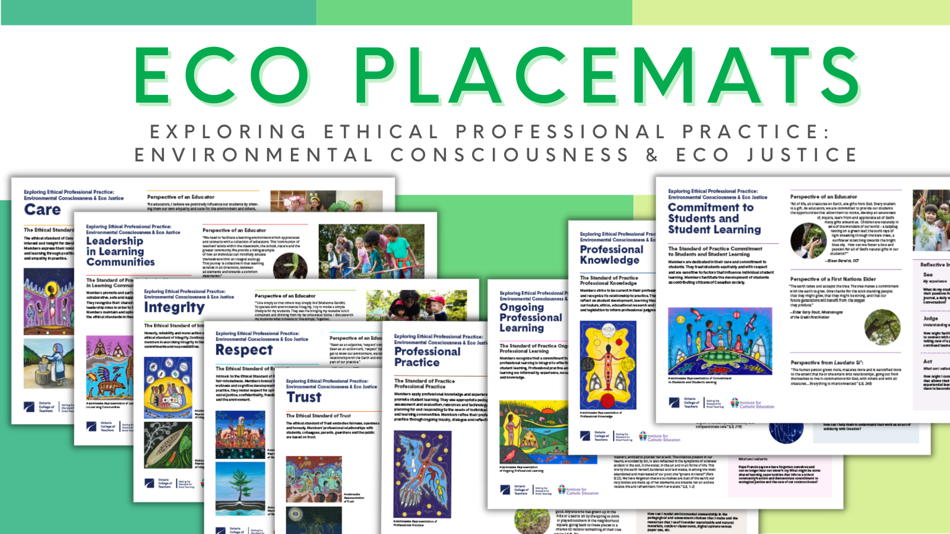
Together with the Ontario College of Teachers, the Institute for Catholic Education has published 9 reflection guides – the “Eco Placemats” – which place the Standards of Ethical and Professional Practice in conversation with our call to a renewed commitment to care for our common home. This resource will help us to reflect using the “way of beauty”.

Slide 4
Pope Francis tells us: We would do well to attend to the “way of beauty” … Every expression of true beauty can thus be acknowledged as a path leading to an encounter with the Lord Jesus. Beauty is a means of touching the human heart and enabling the truth and goodness of the Risen Christ to radiate within it. The Joy of the Gospel, 167

Slide 5
What do you see? How does the Anishinaabe artist’s rendition of the standards help us to know more about what we are called to?

Slide 6
Care

Slide 7
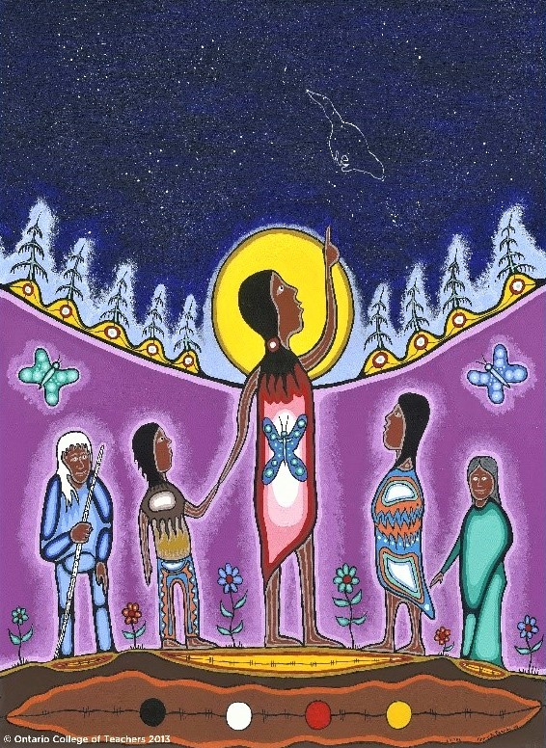

Slide 9
Respect

Slide 10
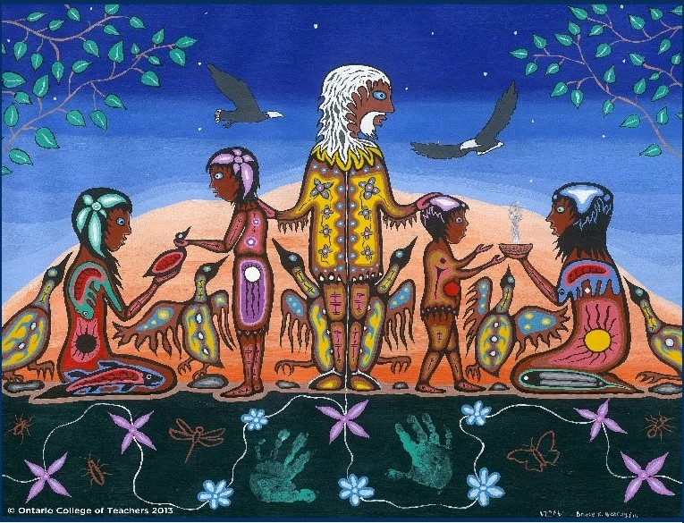

Slide 12
Trust

Slide 13
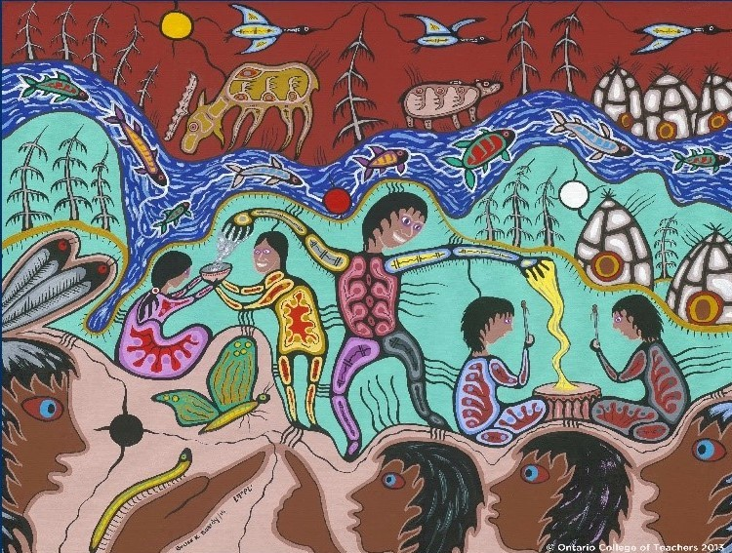

Slide 16
Integrity

Slide 17
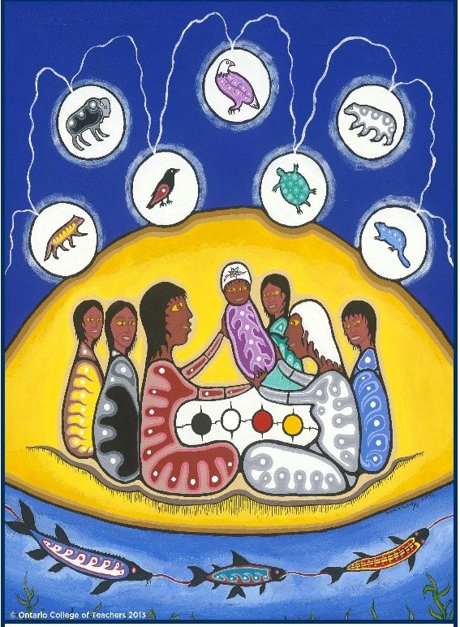

Slide 19
Commitment to Students and Student Learning

Slide 20
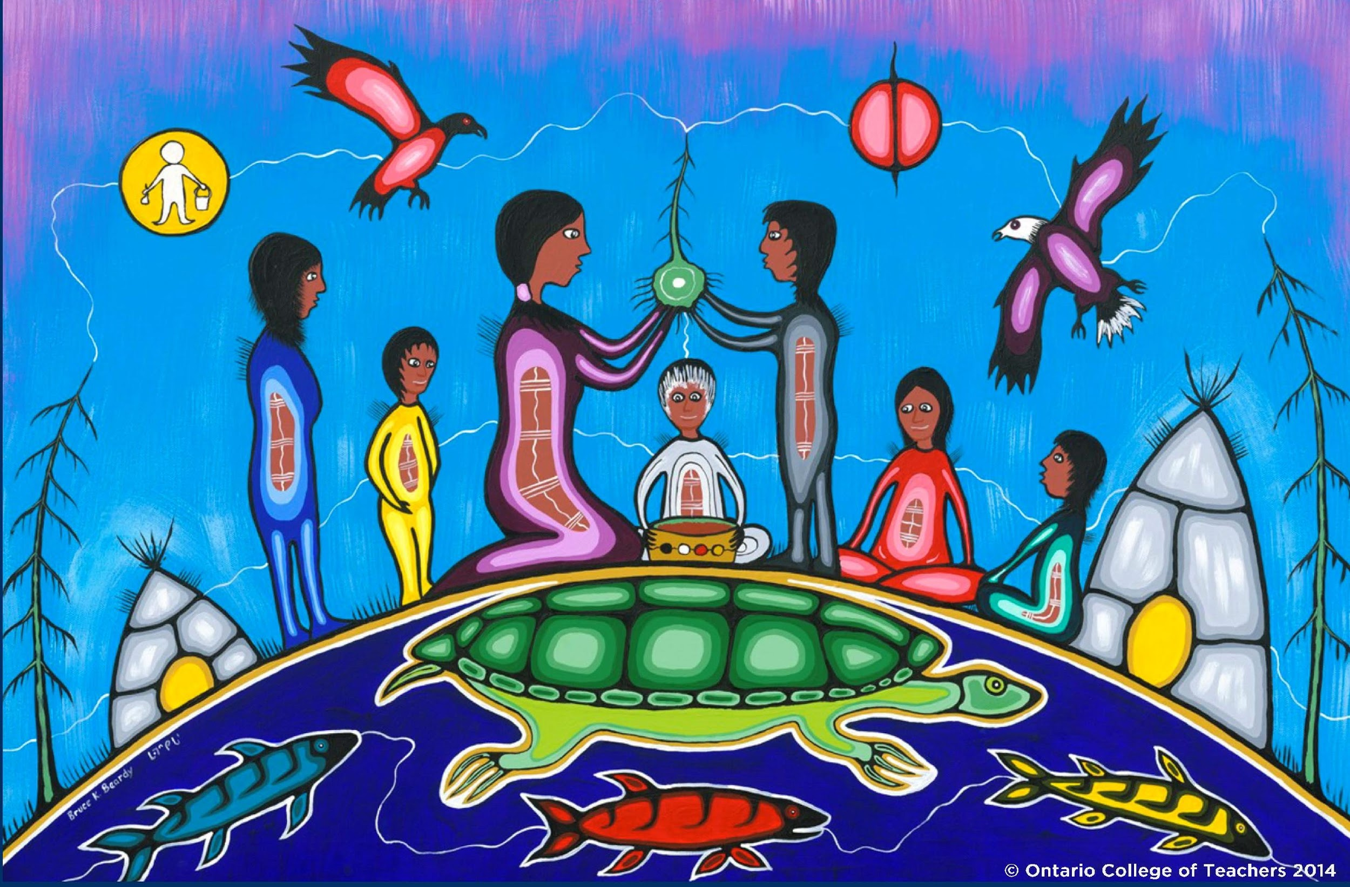

Slide 22
Leadership in Learning Communities

Slide 23
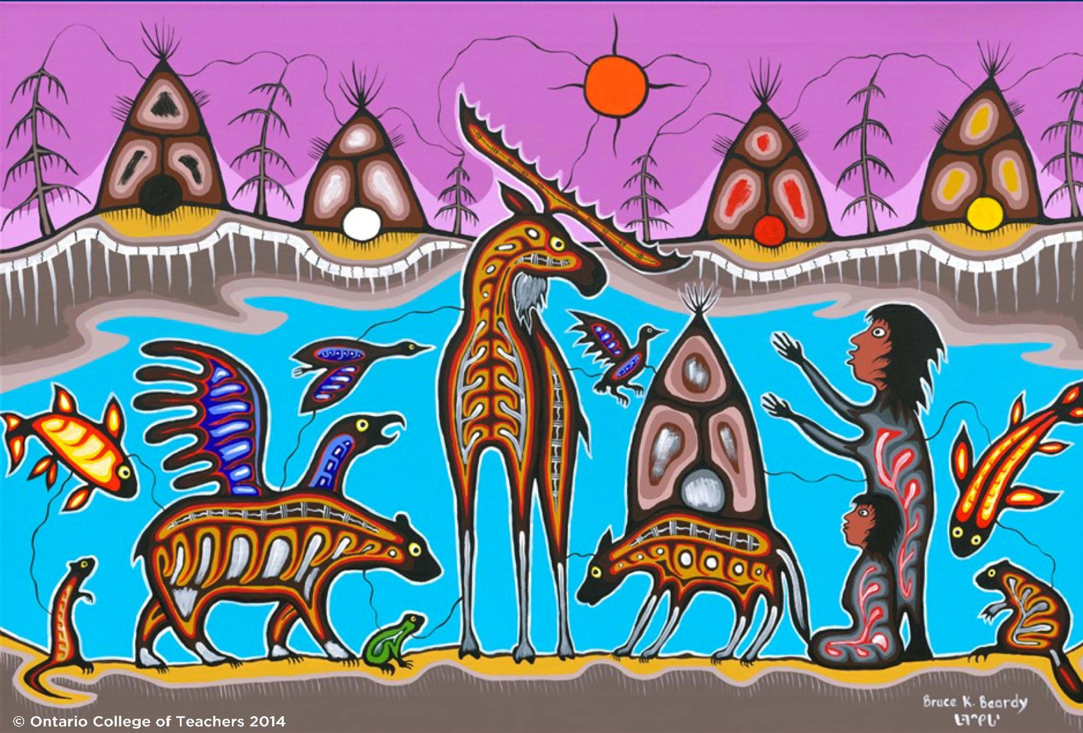

Slide 25
Professional Knowledge

Slide 26
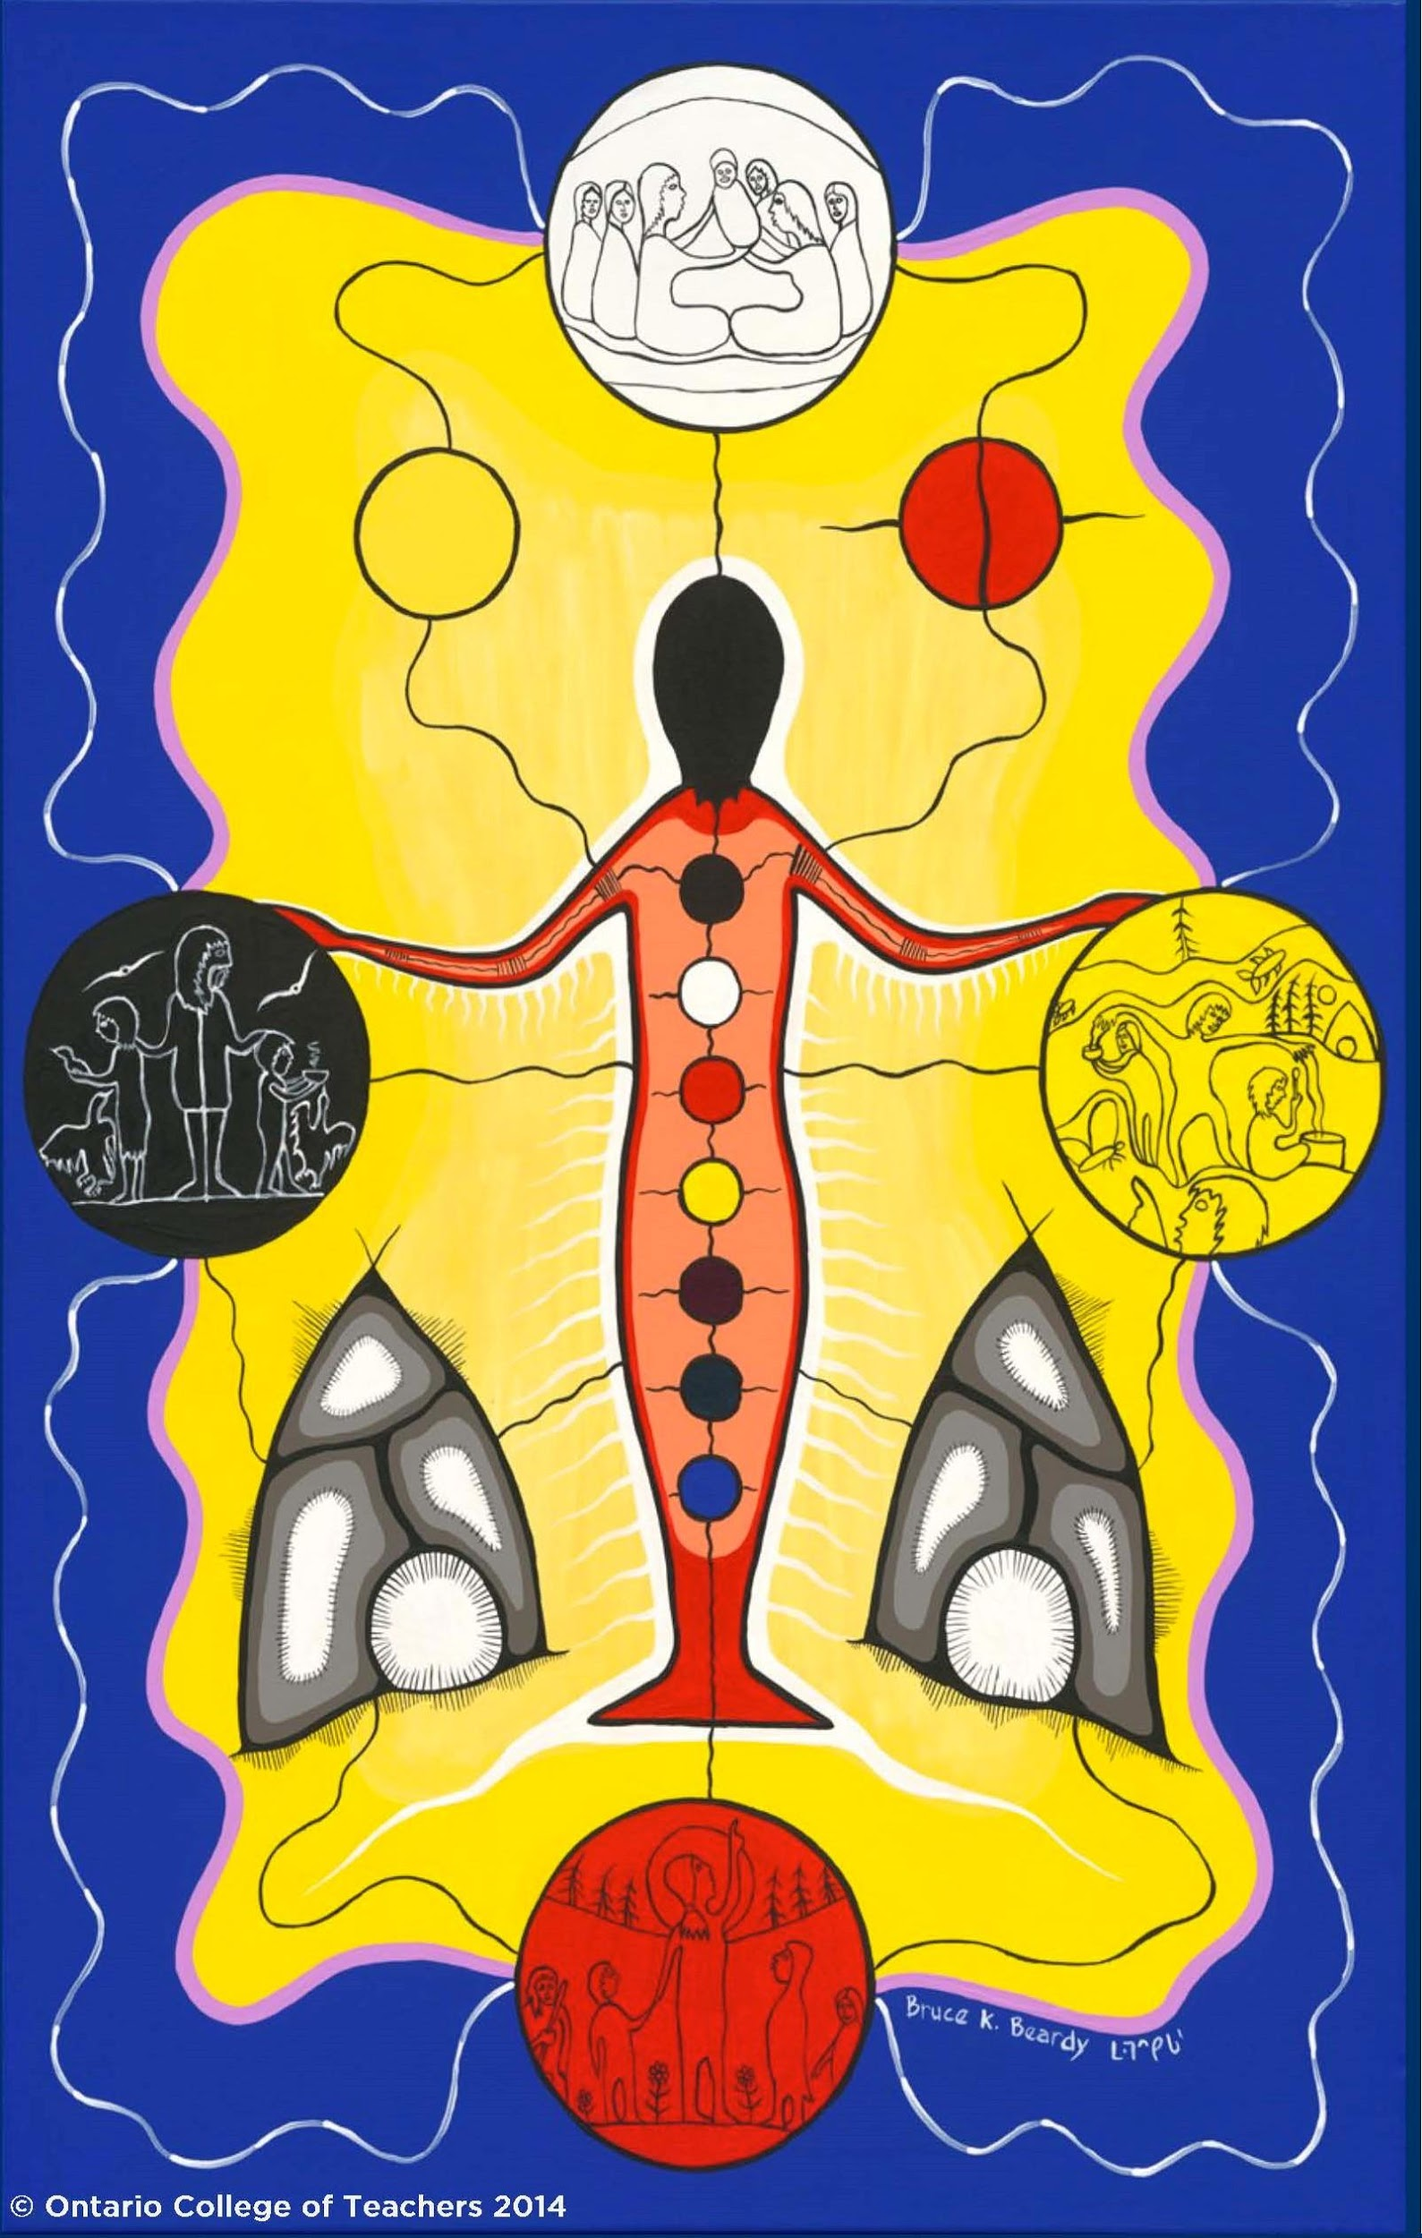

Slide 28
Professional Practice

Slide 29
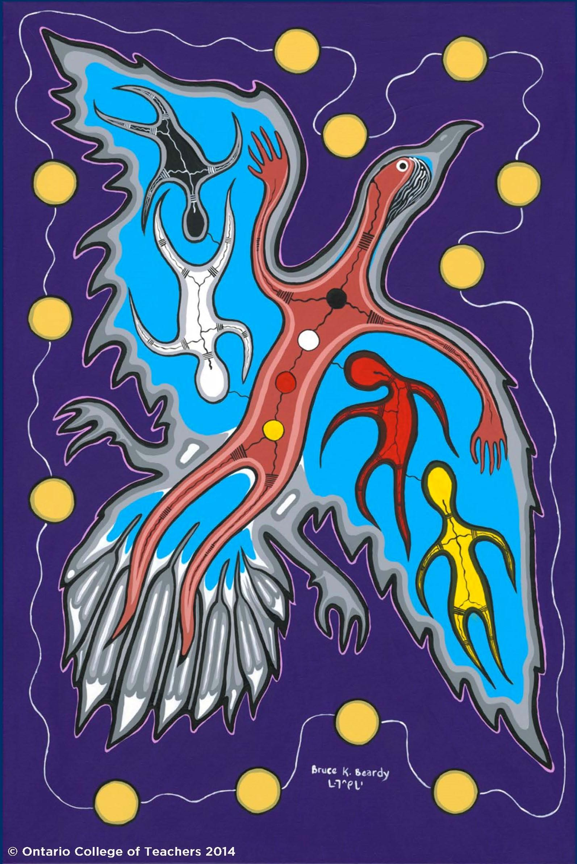

Slide 31
Ongoing Professional Learning

Slide 32
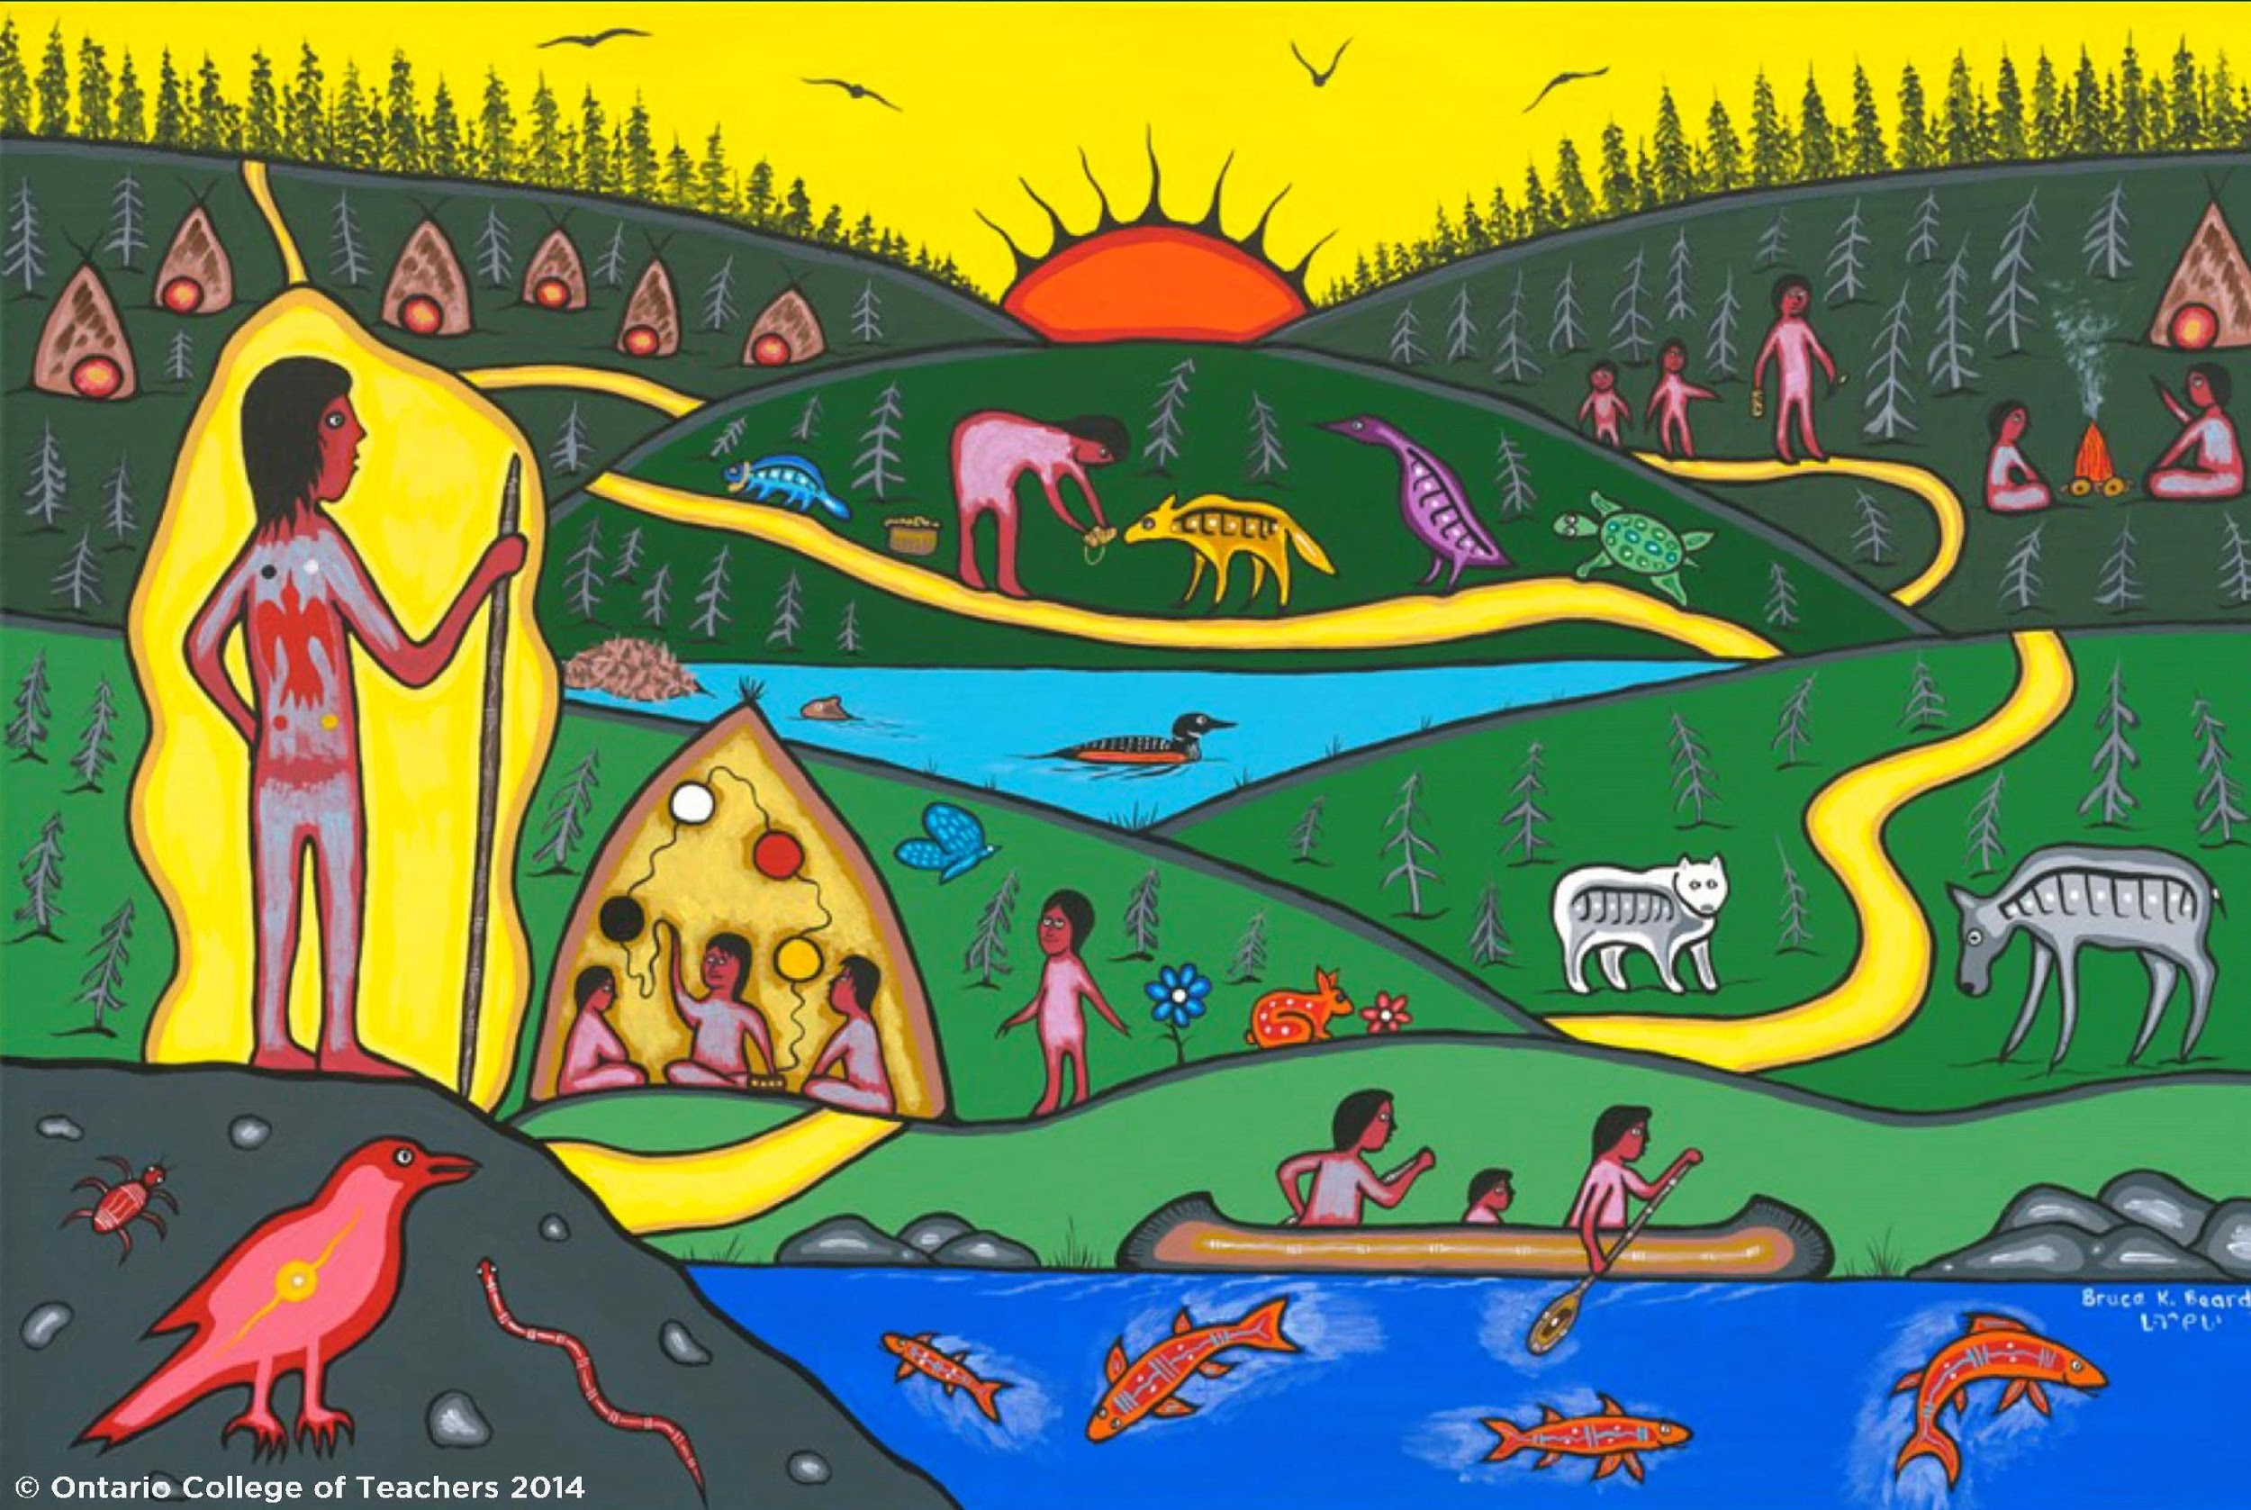

Slide 34
What do you see? How does “the way of beauty” help us to know more about what we are called to do?

